Slide 1
Predicting geopolymer concrete strength from its mix design
Hakem Mohammad Alkhraisha (700043202) · CSBP 711 Advanced AI, Dr. Ahmed Bediwy · Assignment 1 · 4 October 2026
1,136
83
17 + 1
CC BY 4.0
mixes, one row each
study blocks, each citing its paper
raw mix variables + specimen type
open licence (PLOS ONE)
Jiang, Zhao, Jin, Ye, Luan & Tufail (2024), PLOS ONE 19(9): e0310422, S1 Table (file pone.0310422.s002.xlsx) — downloaded 29 Sep 2026
How it was collected: the authors searched Web of Science and Google Scholar, kept only studies reporting every key variable (fly-ash chemistry, mix proportions, activator composition, curing, specimen type, strength), and transcribed 1,136 mixes into one spreadsheet, each block of rows citing its source paper (83 blocks; one paper appears under two spellings).
Task: supervised regression, strength (1–87 MPa) from composition and curing.
Thesis link: my dissertation predicts the constitutive quantities of geopolymer concrete (fracture energy, softening shape) from exactly these inputs, and validates by holding out whole studies. This assignment is that pipeline, tested first on the one target the literature has already compiled.
Repository
github.com/Hakem3011/csbp711-gpc
Working alone
Dataset and pipeline feed directly into the dissertation (WP3)
CSBP 711 · Assignment 1 · Hakem Alkhraisha · 1/5

Slide 2
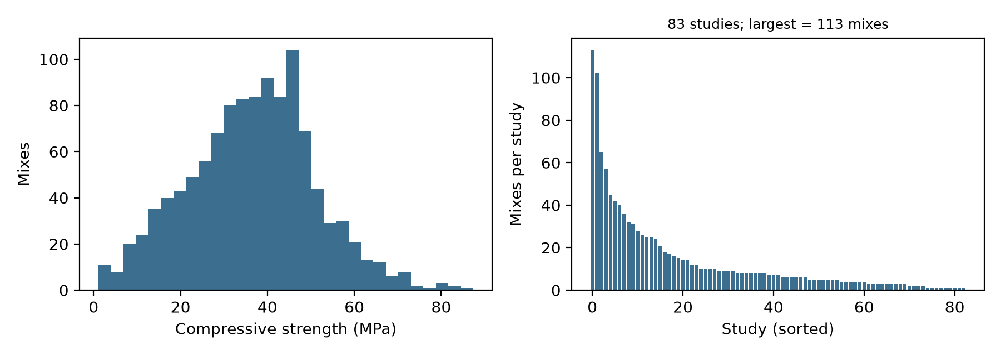
Handling the data: size, features, splits, balance, problems
Every number below is written by run_jiang.py (results/data_audit.txt) or audit_overlap.py (results/overlap_audit.txt)
Size
Features
Splits
Balance
1,136 rows × 41 columns as published
1,122 rows used after duplicates
18 used: 17 numeric mix variables
+ specimen type (cube / cylinder)
5-fold random, and 5-fold holding out
whole study blocks (less leaky), seed 42
Regression, no classes. Strength 1–87 MPa,
mean 36.5; cubes 683 / cylinders 439
Problems found, and what was done
Block-sparse columns (no merged cells): the reference and specimen size are written on the first row of each study block only (1,053 blank reference cells) → forward-filled. Two stray unnamed columns ignored.
Missing values: NaOH solids and water-in-NaOH missing for 79 % of rows → dropped; molarity 22 % and MgO 15 % missing → median-imputed inside each training fold.
Duplicates: 14 exact duplicate rows removed.
Mixed specimens: cube and cylinder strengths in one column → specimen type kept as a feature instead of applying the authors' fixed factors (cylinder × 1.18 below 50 MPa, × 1.04 above).
Derived columns dropped: the authors' ratios (Na/Al, Si/Al, normalised curing) repeat kept columns, except that for 239 of the 247 rows with missing molarity the NaOH-solids columns could have supplied it; I imputed instead (limitation).
Leakage: one block supplies 113 rows (10 %); rows from one laboratory share materials and procedures, so a random split leaks the laboratory into the test set. The by-study split holds out blocks, not laboratories: 15 % of held-out rows (39 % in the worst fold) still share their fly-ash fingerprint with a training row, so it removes most, not all, of the leakage.
Strength distribution (left) and mixes per study (right): a long tail of small studies and one dominant source.
Why the by-study split matters
A random split puts mixes from the same laboratory on both sides, so a model can score well by recognising the laboratory. Holding out whole study blocks asks what a real user asks: can it predict a mix from a source it has never seen? Not perfectly: some laboratories publish several papers, so part of the leakage survives.
CSBP 711 · Assignment 1 · Hakem Alkhraisha · 2/5

Slide 3
Four algorithms, one baseline, one pipeline, one seed
Hyperparameters set in advance and never tuned on either split (no timestamped record exists; stated, not proven)
Ridge regression
Random forest
XGBoost
MLP
Simple baseline
Tree ensemble
Boosted trees
Neural network
Linear, no interactions, cannot bend.
α = 1.0. Deterministic (no seed needed).
500 trees, min 2 samples per leaf, averaged.
random_state = 42.
800 trees, depth 4, learning rate 0.04, subsample 0.9.
random_state = 42.
Two hidden layers (64, 32), ≤ 4,000 iterations, scikit-learn defaults, no early stopping.
random_state = 42.
Identical for all four models
One scikit-learn Pipeline object: median imputation of numeric features → standardisation → one-hot encoding of specimen type → model. The imputer and scaler are fitted on the training fold only, inside every fold, so no test information leaks into preprocessing.
Same folds, same seed: fold assignment uses seed 42 (random split) or the study grouping (by-study split); every model is trained and scored on exactly the same five folds. Models with randomness receive random_state = 42; ridge has none.
What is reported for each model
Task metric: R² and MAE (MPa) on out-of-fold predictions, 5 folds, under both splits.
Training time: seconds to fit all five folds; forest and XGBoost on two cores, ridge and MLP on one.
Model size of the final fold's model: ridge = coefficients; forest and XGBoost = tree nodes; MLP = weights and biases.
All of it in results/comparison.csv, produced by one command.
CSBP 711 · Assignment 1 · Hakem Alkhraisha · 3/5

Slide 4
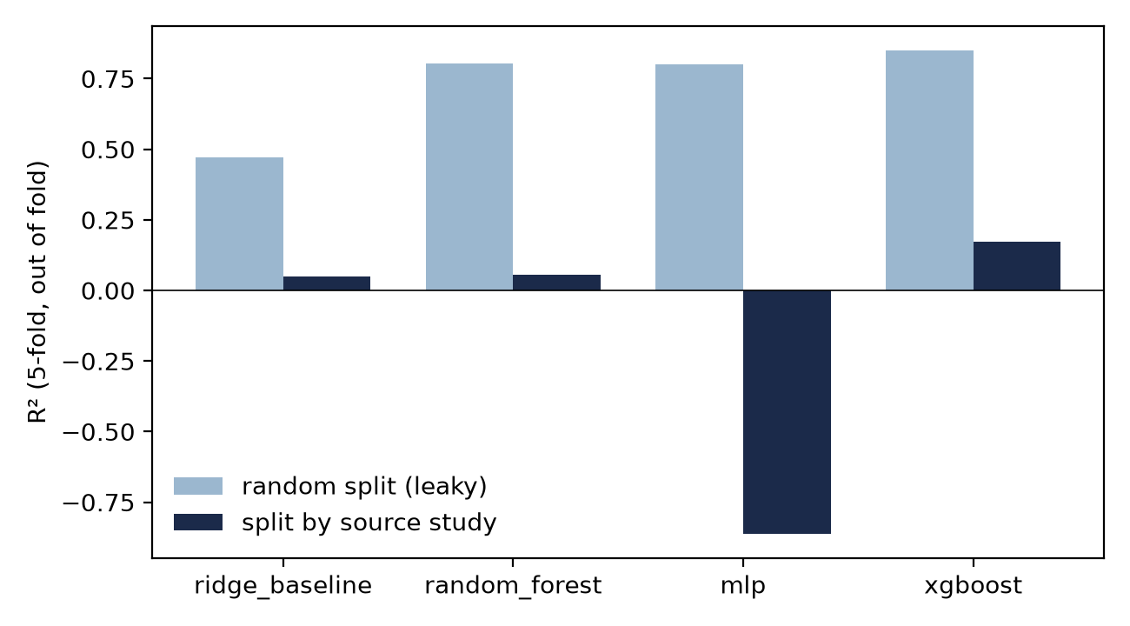
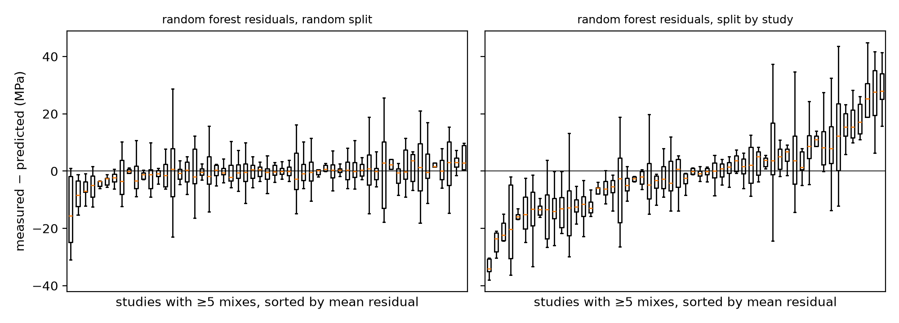
Results: who wins depends on the split
Same models, same preprocessing, same seed — only the split changes
Model | R² random | R² by study | MAE random (MPa) | MAE by study (MPa) | Fit time (s)* | Model size*
Ridge (baseline) | 0.47 | 0.05 | 8.1 | 10.7 | 0.3 | 20 coeff.
Random forest | 0.80 | 0.05 | 4.4 | 11.1 | 6.3 | 231k nodes
MLP (64, 32) | 0.80 | −0.86 | 4.5 | 14.0 | 21.4 | 3.4k weights
XGBoost | 0.85 | 0.16 | 3.7 | 10.6 | 3.7 | ≈22k nodes
* Time = seconds to fit all five folds on the random split, single run (forest and XGBoost on two cores, ridge and MLP on one; times vary by tens of percent between runs). Size = final fold's model: coefficients (ridge), tree nodes (forest, XGBoost), weights and biases (MLP). Seed 42; results/comparison.csv.
Random split: all three non-linear models beat the baseline by a wide margin; XGBoost is best, fastest of the three, and ten times smaller than the forest.
By-study split: every model falls; the forest to the baseline's level on this fold draw, the MLP below predicting the mean. This draw is a pessimistic one: over eight re-drawn fold assignments (results/ablation_folds.csv) XGBoost scores 0.29 ± 0.06, forest 0.13 ± 0.06, ridge 0.05 ± 0.10, MLP −0.60 ± 0.30 — XGBoost first and MLP last in every draw, forest above ridge in six of eight. Even at 0.29, nobody predicts a new source well.
The gap between the two columns is the result, not a nuisance: it is the size of the leakage.
Forest residuals per study (≥5 mixes), sorted. Random split: scatter around zero. By-study split: whole laboratories sit above or below — the error is the laboratory, not the mix.
CSBP 711 · Assignment 1 · Hakem Alkhraisha · 4/5

Slide 5
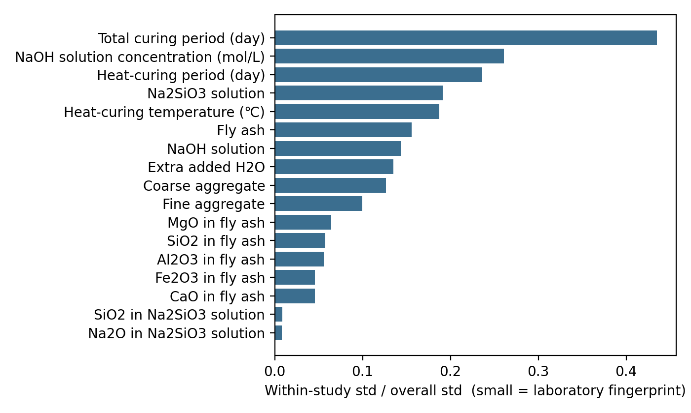
Why XGBoost won: laboratory memory, then the residual
Two data properties, predictions stated in advance, five ablations
Data property 1. 61 % of the variance in strength lies between study blocks, and fly-ash oxides and silicate composition barely vary within a block (chart), so on a random split a tree can identify the source and inherit its strength level.
Prediction 1 (in advance). (a) Hold out whole blocks and every model should fall to the baseline's level; (b) give every model the block identity and the baseline should rise while the trees barely move.
Result 1. (b) held: ridge 0.47 → 0.70, trees ±0.01; block mean alone 0.53 > ridge 0.47. (a) held for the MLP, is within fold-draw noise for the forest (0.13 ± 0.06 vs ridge 0.05 ± 0.10), and failed for XGBoost (0.29 ± 0.06, first in 8 of 8 draws). So the laboratory property explains the trees' lead over ridge, not XGBoost's margin over the forest.
R², seed 42: random / held out | Ridge | Forest | XGBoost | MLP
Mix variables | 0.47 / 0.05 | 0.80 / 0.05 | 0.85 / 0.16 | 0.80 / −0.86
+ block identity (random only) | 0.70 | 0.81 | 0.84 | 0.80
Block mean only, no mix variables | 0.53 | — | — | —
Forest limited to depth 4 | — | 0.58 / 0.02 | — | —
Bagged vs boosted trees, depth 4 | — | 0.57 / −0.03 | 0.85 / 0.16 | —
8 fold draws, held out, mean ± sd | 0.05 ± 0.10 | 0.13 ± 0.06 | 0.29 ± 0.06 | −0.60 ± 0.30
Within-block spread of each feature as a fraction of its overall spread. Near zero = a source fingerprint.
Data property 2, and the test that closed the gap. Strength here is a large between-laboratory offset plus a small within-laboratory signal (curing, molarity). Prediction 2 (in advance): if fitting residuals is what lets XGBoost keep a margin, then boosted trees should beat bagged trees from the same library at the same depth 4 and the same sampling when blocks are held out — removing depth and capacity from the comparison. Result: boosted 0.16 vs bagged −0.03 by block (0.85 vs 0.57 random). Averaging independent trees re-fits the offset in every tree; boosting absorbs the offset in the first trees and then fits the residual, which is the only part that transfers to a new source.
Limits. The depth test could not separate depth from capacity (the depth-4 forest underfits the random split too). Blocks are not laboratories: 15 % of held-out rows share a fly-ash fingerprint with training, so every by-study score is an upper bound. Implication for my thesis: R² above 0.9 on a random split of a compiled database is memorisation; WP3 validates by held-out study.
CSBP 711 · Assignment 1 · Hakem Alkhraisha · 5/5

